Slide 1


Best choice for newcomers to Singapore

Slide 2
1
2
3
You’re looking for
Short stay
Single and Couple
Low-cost Trip
Casual stay within a week
Suitable for both single and couple
The better price
The better saving

Slide 3
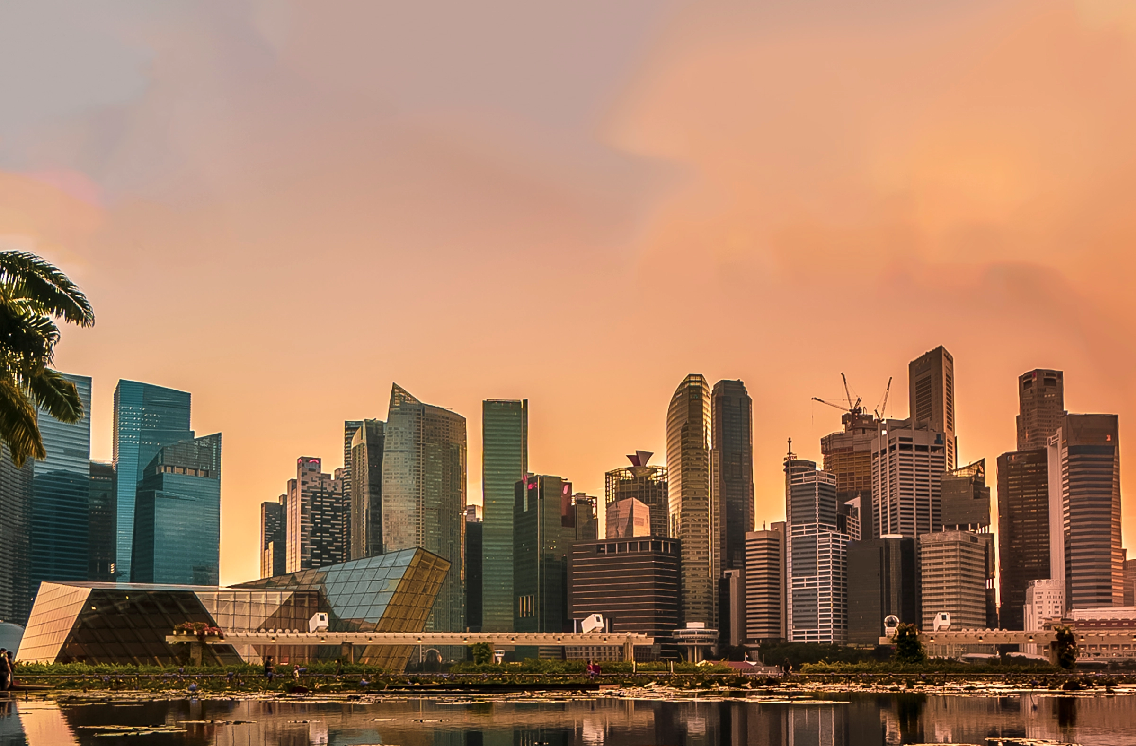
When & Where
WHEN is the balance time to visit and renting not too high
WHERE is the convenient of transportation and entertainment

Slide 4
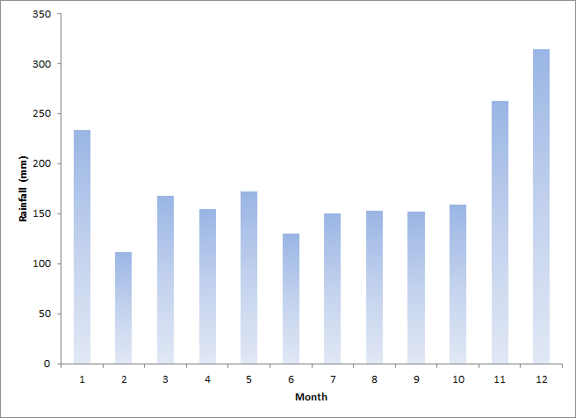
WHEN to come …
According to www.weather.gov.sg, rainfall is plentiful in Singapore and it rains an average of 167 days in a year.
Mostly from the lately of October to the February in the next year.

Slide 5
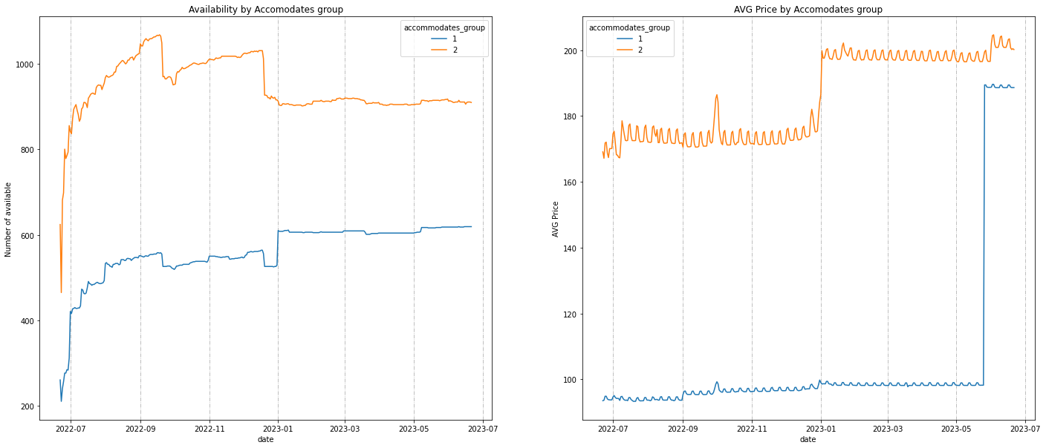
WHEN to come …
Add boxplot to compare the price distribution
Heavy rainy season

Slide 6
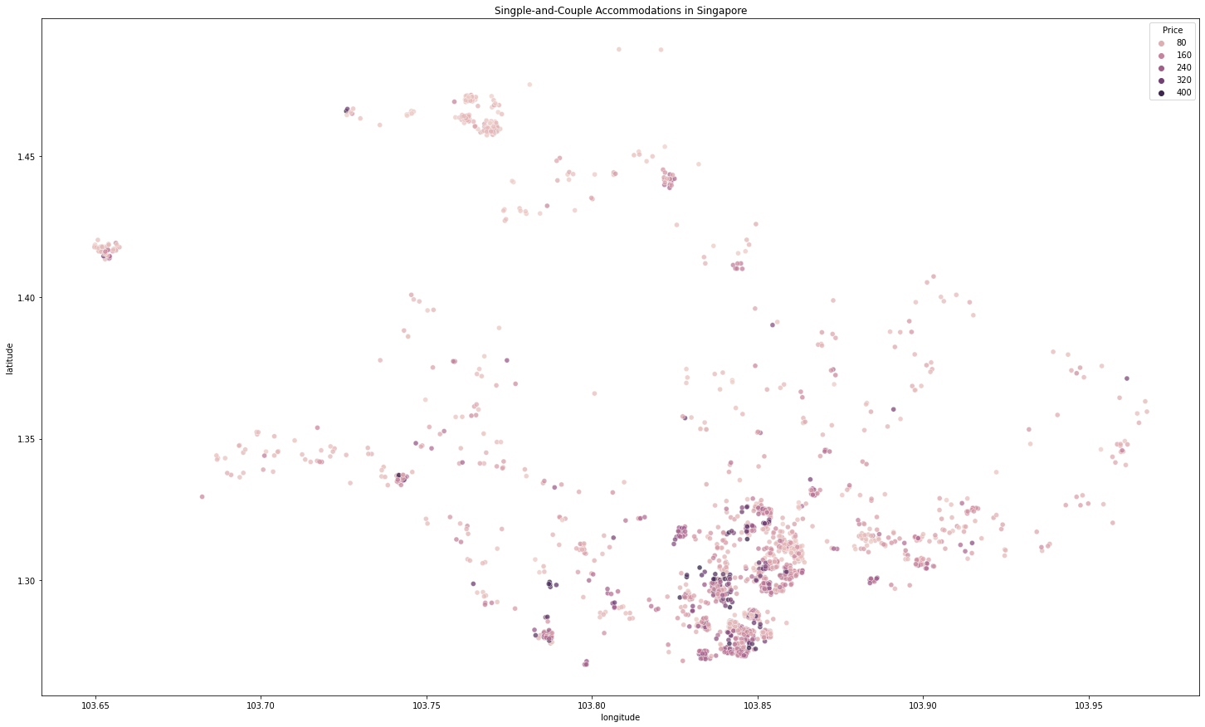
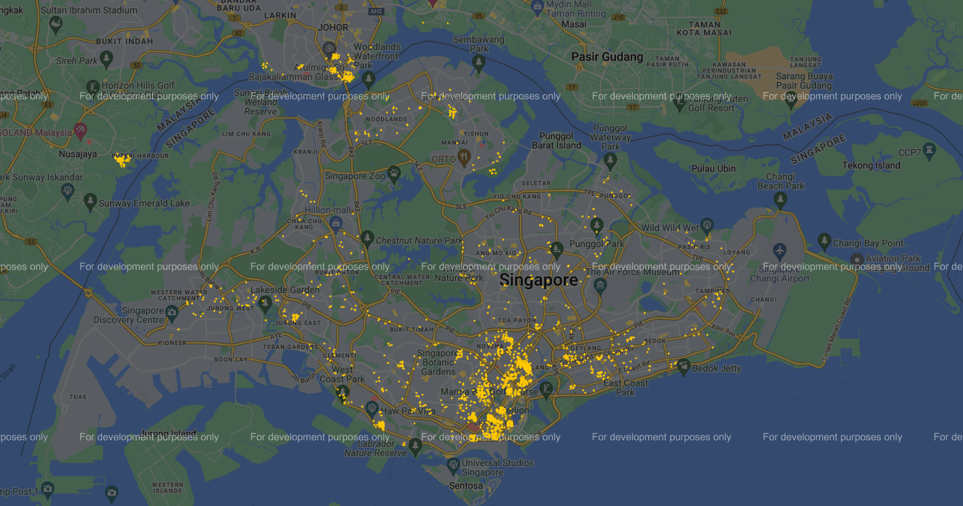
WHERE to stay…
Rochor & Victoria Crossroad
China town

Slide 9
Contents of This Template
Here’s what you’ll find in this Slidesgo template:
A slide structure based on a business plan, which you can easily adapt to your needs. For more info on how to edit the template, please visit Slidesgo School or read our FAQs.
An assortment of pictures that are suitable for use in the presentation can be found in the alternative resources slide.
A thanks slide, which you must keep so that proper credits for our design are given.
A resources slide, where you’ll find links to all the elements used in the template.
Instructions for use.
Final slides with:
The fonts and colors used in the template.
A selection of illustrations. You can also customize and animate them as you wish with the online editor. Visit Stories by Freepik to find more.
More infographic resources, whose size and color can be edited.
Sets of customizable icons of the following themes: general, business, avatar, creative process, education, help & support, medical, nature, performing arts, SEO & marketing, and teamwork.
You can delete this slide when you’re done editing the presentation.

Slide 10
Our Company
Mercury is the closest planet to the Sun and the smallest one in the Solar System—it’s only larger than the Moon
HOTEL
& SPA

Slide 11
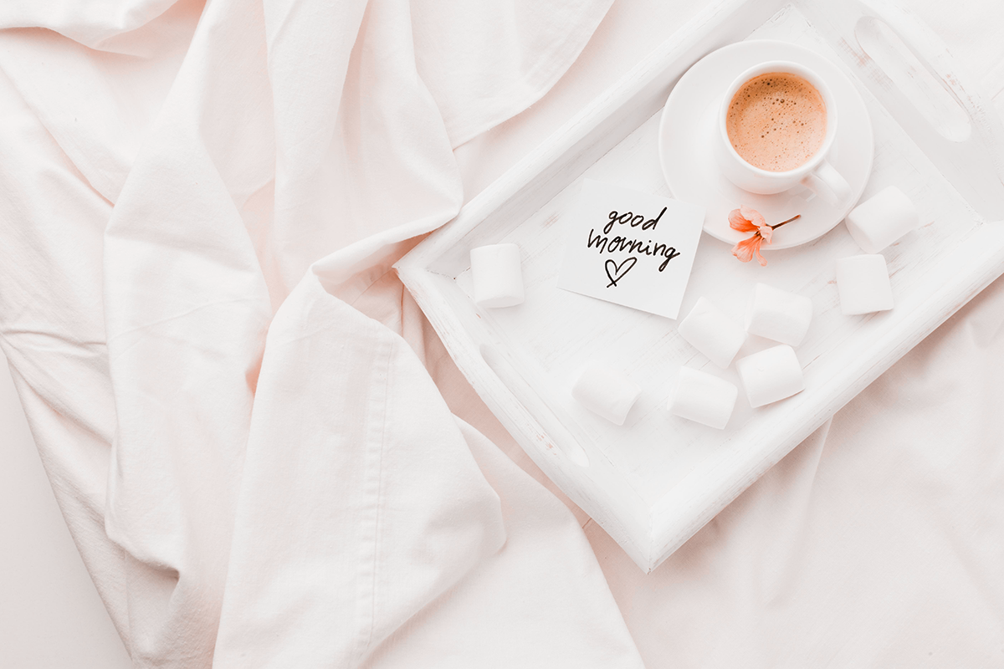
1
Business Overview

Slide 12
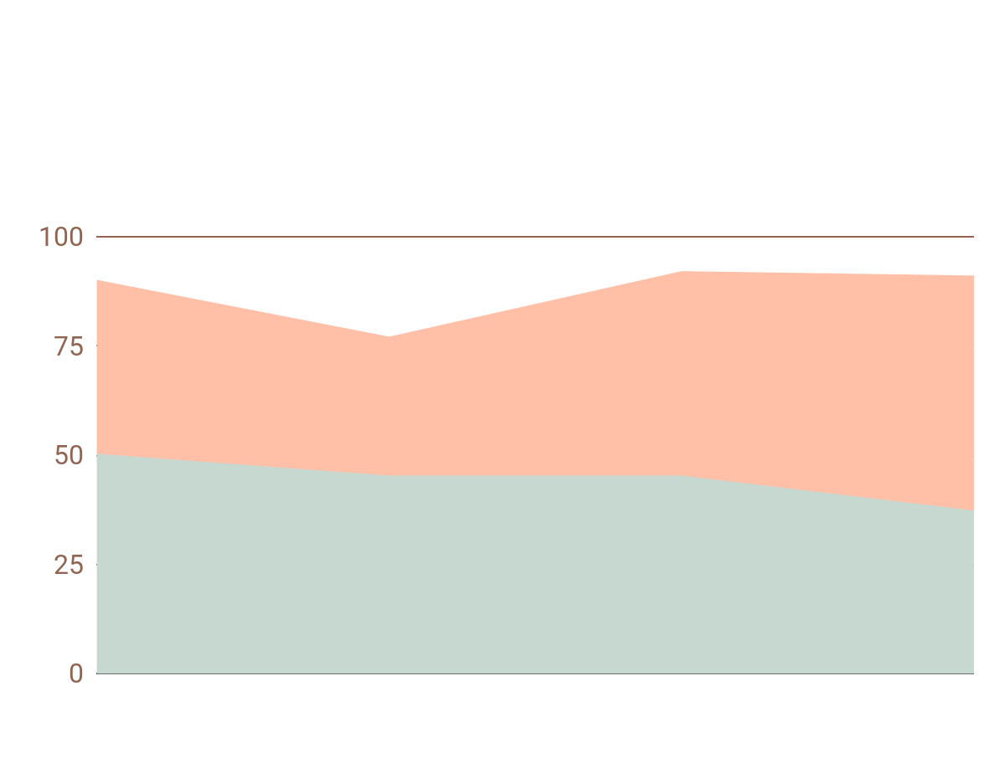
Market Trends
1
Mars
2
Saturn
It’s full of iron oxide, giving the planet its reddish cast
To modify this graph, click on it, follow the link, change the data and paste the resulting graph here, replacing this one
It’s a gas giant, composed of hydrogen and helium

Slide 13
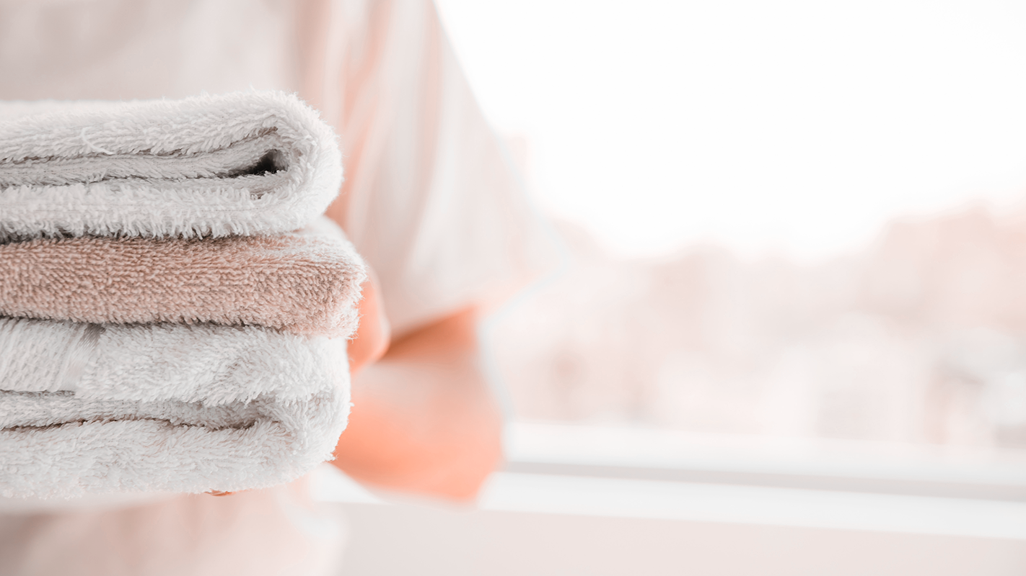
Problem
Solution
Mercury is the closest planet to the Sun and the smallest one
Venus has a beautiful name and is the second planet from the Sun

Slide 14
Mars
Jupiter
Saturn
Competitors
It’s full of iron oxide dust, giving the planet its reddish cast
It’s a gas giant and the biggest planet in the Solar System
It’s a gas giant, composed mostly of hydrogen and helium

Slide 15
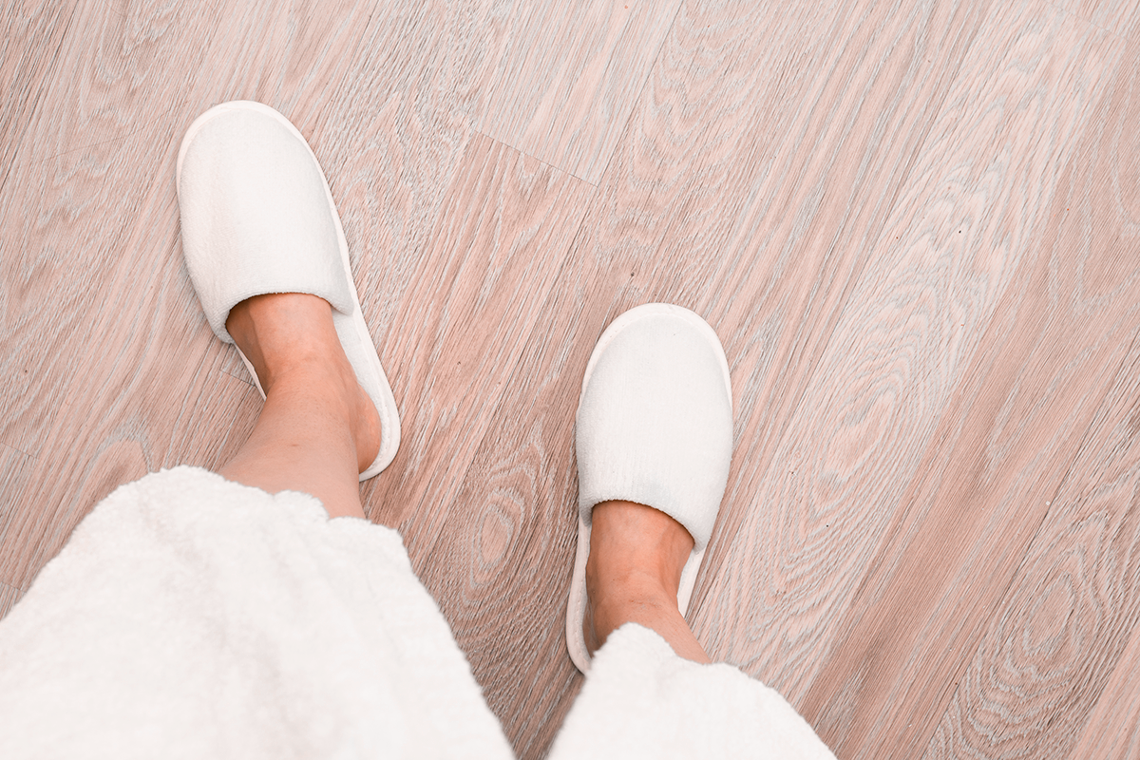
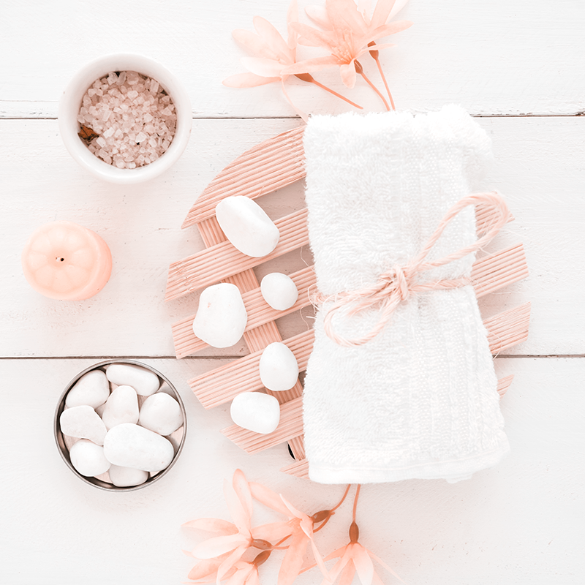
Them
Us
Mercury is the closest planet to the Sun and the smallest one
Venus has a beautiful name and is the second planet from the Sun

Slide 16

2
Market Analysis

Slide 17
Target
Location
Specialization
Employees
60%
Receptionists
Bellhops
40%
Janitors
20
30
25
Yes, this is the ringed planet
Cooks
America
Europe

Slide 18
Market Size
35%
Jupiter
40%
Mars
25%
Mercury

Slide 19
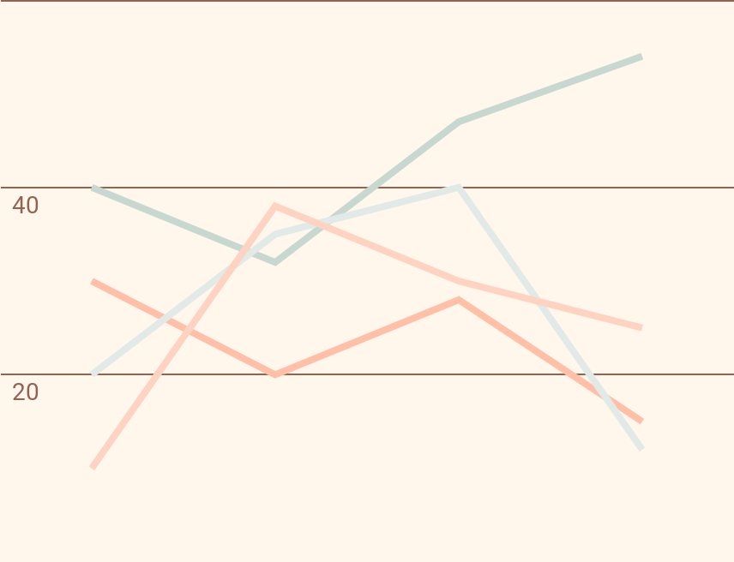
Market Share
Jupiter
Mercury
Venus
Mars
Jupiter is the biggest planet in the Solar System
Mercury is the closest planet to the Sun
Venus is even hotter than Mercury
Despite being red, Mars is a cold place
To modify this graph, click on it, follow the link, change the data and paste the new graph here

Slide 20
4,985,000
Big numbers catch your audience’s attention

Slide 21
Competition Analysis
Jupiter | Mercury | Venus | Mars
Yes | No | No | Yes
Yes | Yes | No | Yes
No | Yes | Yes | No

Slide 22

3
Marketing Plan

Slide 23
Our Services
Mercury
Venus
Mars
Jupiter
Saturn
Neptune
It’s the closest planet to the Sun
It has a beautiful name, but it’s hot
Despite being red, Mars is a cold place
It’s the biggest in the Solar System
Saturn is the ringed one and a gas giant
It’s the farthest planet from the Sun

Slide 24
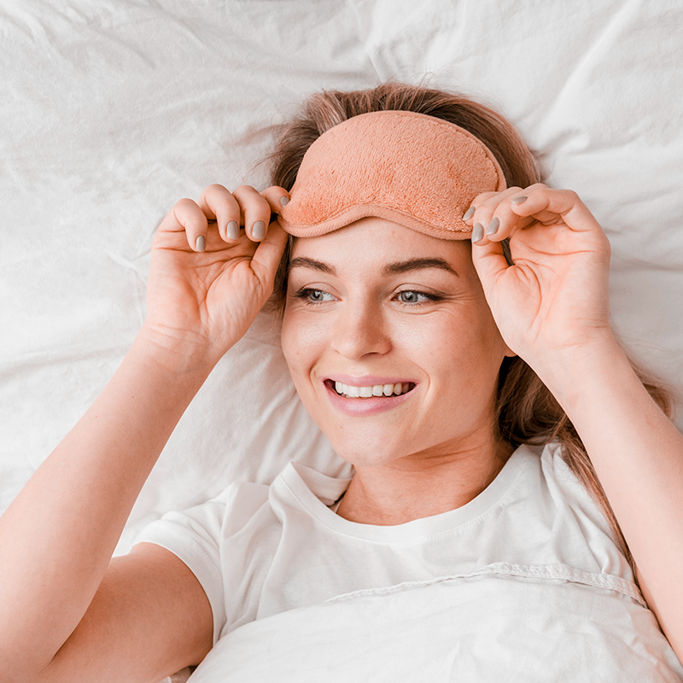
—Someone Famous
“This is a quote, words full of wisdom that someone important said and can make the reader get inspired.”

Slide 25
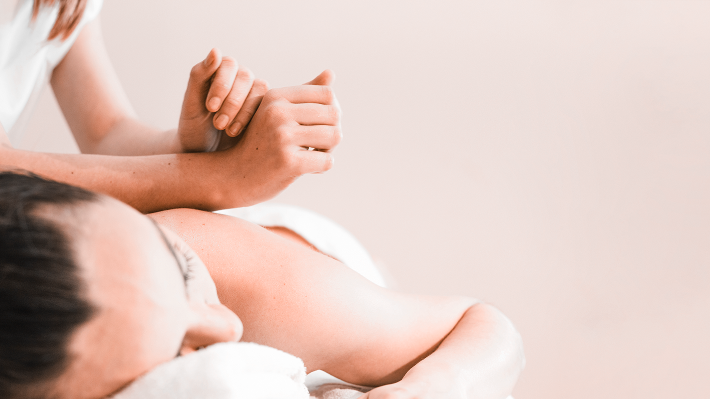
A Picture Is Worth a Thousand Words

Slide 26
Break-Even Analysis
Break-Even Point
Big Loss
Loss
Profit
High Profit
Jupiter is the biggest planet in the Solar System
Mercury is the closest planet to the Sun
Despite being red, Mars is actually a cold place
Saturn is the ringed one and a gas giant
Neptune is the farthest planet from the Sun

Slide 27
Basic
I
Pro
II
Premium
III
Our Plans
Mercury is the closest planet to the Sun and the smallest
Saturn is a gas giant, composed mostly of hydrogen and helium
Jupiter is the biggest planet in the Solar System

Slide 28
Sales and Distribution
Channel 2
Channel 4
Venus has a beautiful name
Earth is the planet we live on
Channel 1
Channel 3
Mars is actually a cold place
Saturn is the ringed planet

Slide 29
Advertising and Promotion
1
2
3
Advertising
PR
Online
Mercury is the closest planet to the Sun and the smallest one in the Solar System
Venus has a beautiful name and is the second planet from the Sun. It’s terribly hot
Despite being red, Mars is actually a cold place. The planet is full of iron oxide dust

Slide 30

Management Plan
4

Slide 31



Our Team
James Price
Helena Doe
Mary Roe
You can replace the image on the screen with your own one
You can replace the image on the screen with your own one
You can replace the image on the screen with your own one

Slide 32
Organizational Chart
Mercury
Mars
Moon
Pluto
Earth
Venus
Mercury
Jupiter
Saturn

Slide 33
Our Partners
A
B
Mars
Jupiter
C
D
Venus
Mercury
Despite being red, actually Mars is cold
It’s the biggest planet in the Solar System
It has a beautiful name, but it’s terribly hot
Mercury is the closest planet to the Sun

Slide 34

05
Operating Plan

Slide 35
Our Process
1
2
3
4
5
Jupiter is the biggest planet of them all
Saturn is the ringed planet and a gas giant
Mercury is the closest planet to the Sun
Despite being red, Mars is a cold place
Venus has a beautiful name, but it’s hot

Slide 36
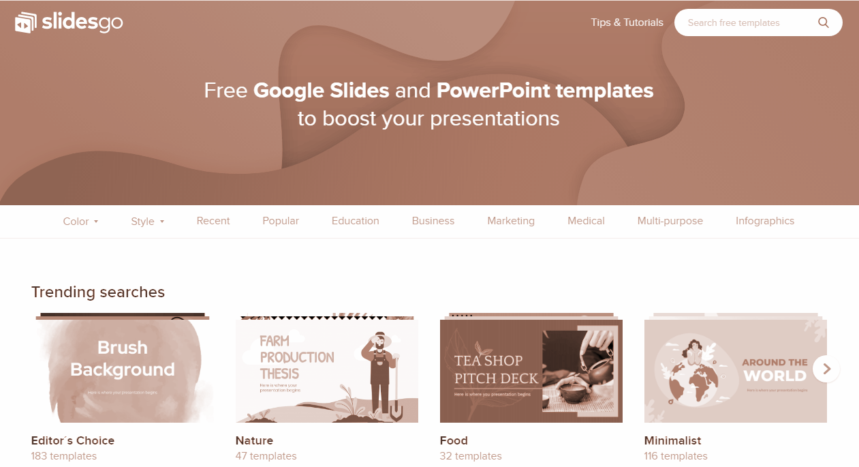
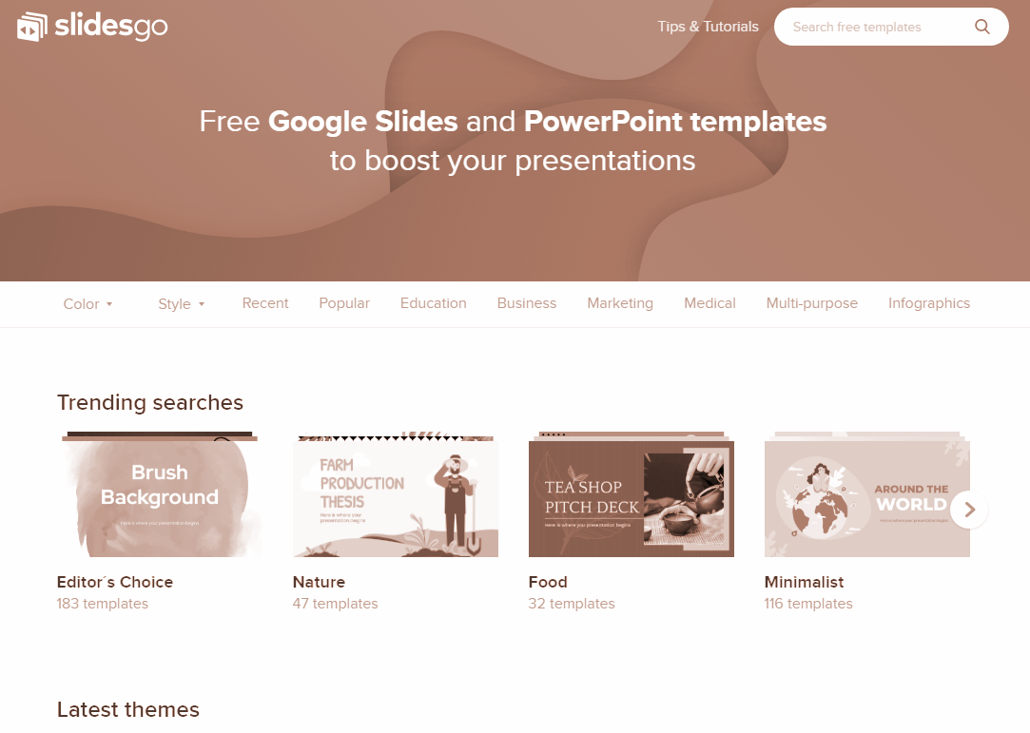
Social Media
You can replace the image on these screens with your own work. Just delete these ones and add yours

Slide 37
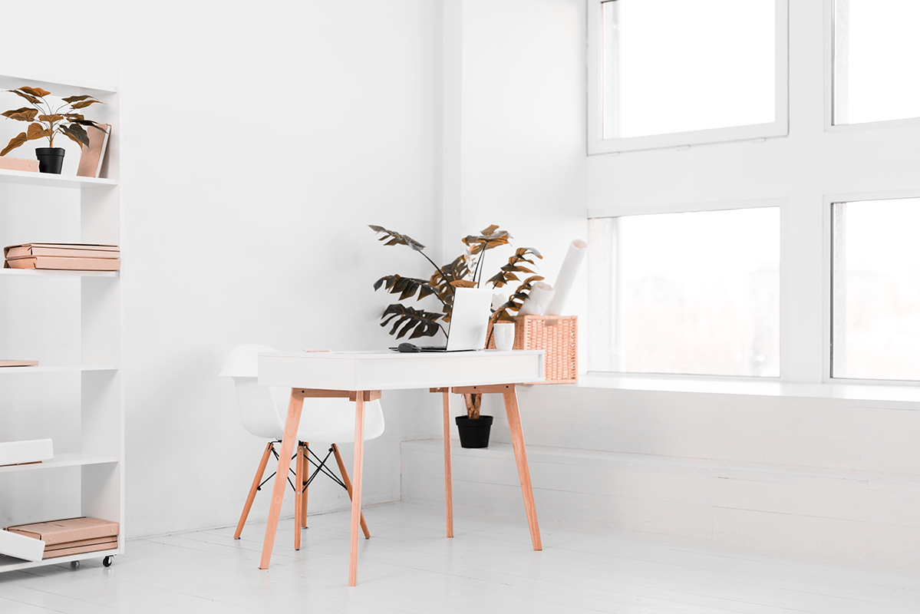
Financial Plan
06

Slide 38
Predicted Growth
70%
60%
Venus has a beautiful name, but it’s hot
Jupiter is the biggest planet of them all
30%
50%
Despite being red, Mars is a cold place
Saturn is composed of hydrogen and helium

Slide 39
Balance Sheet
1M
300K
700K
Assets
Liabilities
Equity
Mercury is the closest planet to the Sun
Jupiter is the biggest planet of them all
Despite being red, Mars is a cold place

Slide 40
Thanks
Do you have any questions?
youremail@freepik.com
+91 620 421 838
yourcompany.com
Please keep this slide for attribution

Slide 41
Alternative Resources
Photos
Brown towels sitting shelf
Service bell wooden counter
Couple cuddling bed having breakfast
Vase with flowers bedroom
Adult male enjoying cup coffee
Minimal interior design
Close up tray with breakfast bed
High angle woman eating breakfast bed
Top view spa element collection
Stacked towels brush soap cosmetic bottle wooden surface
High angle view woman receiving back massage from therapist
Young woman sitting bed stretching her hand with breakfast table
Portrait smiling chambermaid holding soft white pillow hand

Slide 42
Resources
Vectors
Hand drawn karaoke poster template
Collection flat gadgets
Photos
Tray with breakfast bed
Tray with coffee bed
Woman wearing bathrobe hotel room
Person with stack terrycloth towels
Person with white shoes
Spa medical accessories table
Young woman opening curtains
Luxurious vintage bedroom design
Portrait woman sitting bed
Massage concept with woman
Alarm clock wooden desk bedroom
Front view man white t-shirt
Cheerful adult woman
Cheerful woman white t-shirt
Adult male enjoying cup coffee
Nordic style office with desk plants

Slide 43
Instructions for use (free users)
In order to use this template, you must credit Slidesgo by keeping the Thanks slide.
You are allowed to:
Modify this template.
Use it for both personal and commercial purposes.
You are not allowed to:
Sublicense, sell or rent any of Slidesgo Content (or a modified version of Slidesgo Content).
Distribute this Slidesgo Template (or a modified version of this Slidesgo Template) or include it in a database or in any other product or service that offers downloadable images, icons or presentations that may be subject to distribution or resale.
Use any of the elements that are part of this Slidesgo Template in an isolated and separated way from this Template.
Delete the “Thanks” or “Credits” slide.
Register any of the elements that are part of this template as a trademark or logo, or register it as a work in an intellectual property registry or similar.
For more information about editing slides, please read our FAQs or visit Slidesgo School:
https://slidesgo.com/faqs and https://slidesgo.com/slidesgo-school

Slide 44
Instructions for use (premium users)
In order to use this template, you must be a Premium user on Slidesgo.
You are allowed to:
Modify this template.
Use it for both personal and commercial purposes.
Hide or delete the “Thanks” slide and the mention to Slidesgo in the credits.
Share this template in an editable format with people who are not part of your team.
You are not allowed to:
Sublicense, sell or rent this Slidesgo Template (or a modified version of this Slidesgo Template).
Distribute this Slidesgo Template (or a modified version of this Slidesgo Template) or include it in a database or in any other product or service that offers downloadable images, icons or presentations that may be subject to distribution or resale.
Use any of the elements that are part of this Slidesgo Template in an isolated and separated way from this Template.
Register any of the elements that are part of this template as a trademark or logo, or register it as a work in an intellectual property registry or similar.
For more information about editing slides, please read our FAQs or visit Slidesgo School:
https://slidesgo.com/faqs and https://slidesgo.com/slidesgo-school

Slide 45
Fonts & colors used
This presentation has been made using the following fonts:
Carter One
(https://fonts.google.com/specimen/Carter+One)
Livvic
(https://fonts.google.com/specimen/Livvic)
#fff6ec
#fed3c2
#ffc0a7
#c7d8d0
#e1eae7

Slide 46





Stories by Freepik
Create your Story with our illustrated concepts. Choose the style you like the most, edit its colors, pick the background and layers you want to show and bring them to life with the animator panel! It will boost your presentation. Check out How it Works.
Pana
Amico
Bro
Rafiki
Cuate

Slide 47
Use our editable graphic resources...
You can easily resize these resources without losing quality. To change the color, just ungroup the resource and click on the object you want to change. Then, click on the paint bucket and select the color you want. Group the resource again when you’re done. You can also look for more infographics on Slidesgo.

Slide 50
JANUARY
FEBRUARY
MARCH
APRIL
MAY
JUNE
PHASE 1
Task 1
Task 2
PHASE 2
Task 1
Task 2
JANUARY
FEBRUARY
MARCH
APRIL
PHASE 1
Task 1
Task 2

Slide 53
...and our sets of editable icons
You can resize these icons without losing quality.
You can change the stroke and fill color; just select the icon and click on the paint bucket/pen.
In Google Slides, you can also use Flaticon’s extension, allowing you to customize and add even more icons.

Slide 54
Educational Icons
Medical Icons

Slide 55
Business Icons
Teamwork Icons

Slide 56
Help & Support Icons
Avatar Icons

Slide 57
Creative Process Icons
Performing Arts Icons

Slide 58
Nature Icons

Slide 59
SEO & Marketing Icons

Slide 60


